Slide 1
Lab 2: Basic SELECT statements

Slide 2
Display a table’s structure
desc film;
describe film;

Slide 3
Retrieving data from a table using the SELECT Statement
SELECT * FROM actor;
SELECT first_name, last_name FROM actor;
SELECT payment_id, customer_id, amount+1 FROM payment;
SELECT payment_id, customer_id, sum(amount) FROM payment;
SELECT payment_id, customer_id, round(amount) FROM payment;

Slide 4
Retrieving data from a table using the SELECT Statement
SELECT payment_id, customer_id, round(amount) rounding FROM payment;
SELECT payment_id, customer_id, round(amount) AS ‘rounding amount’ FROM payment;

Slide 5
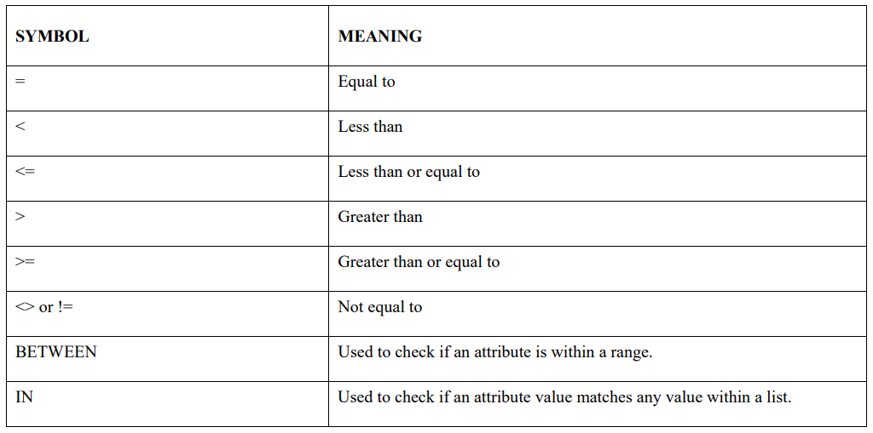
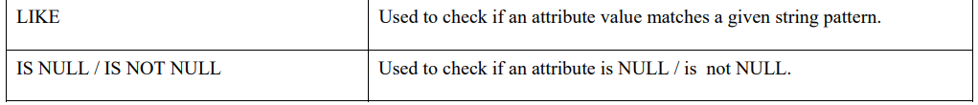
Selecting rows with conditional restrictions

Slide 6
Selecting rows with conditional restrictions
SELECT payment_id, customer_id, amount FROM payment WHERE amount > 1.99;
Modify the query to display total amount of the payments with amount more than 10.99.

Slide 7
Selecting rows with conditional restrictions
SELECT film_id, title, release_year FROM film WHERE title < ‘B’;
SELECT * FROM film WHERE title BETWEEN ‘B’ AND ‘C’;
Write a query which displays the payment_id, payment_date, amount where the payment is not equal to 0.99.

Slide 8
Selecting rows with conditional restrictions
SELECT * FROM film WHERE rating IN (‘R’, ‘NC-17’);
SELECT * FROM film WHERE title LIKE 'B%’;
SELECT * FROM address WHERE address2 IS NULL;
Write a query which displays all attributes in address where the address2 is not null.

Slide 9
Logical Operators
SELECT * FROM city WHERE city LIKE 'a%' AND city LIKE '%a’;
SELECT * FROM city WHERE city LIKE 'a%’ OR city LIKE '%a’;
SELECT * FROM city WHERE NOT city LIKE 'a%’;
Display title and length of film having length less than 60 or more than 100.

Slide 10
Sorting Data
SELECT * FROM film ORDER BY rating;
SELECT * FROM film ORDER BY rating, title;
SELECT * FROM film ORDER BY rating, title DESC;

Slide 11
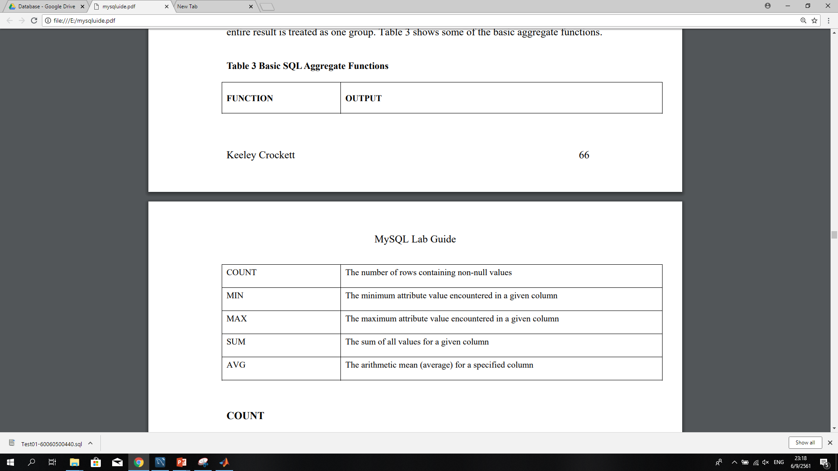
Aggregate Functions

Slide 12
Aggregate Functions
SELECT DISTINCT(rating) FROM film;
SELECT COUNT(*) FROM address;
SELECT COUNT(address2) FROM address;
SELECT COUNT(DISTINCT(rating)) FROM film;

Slide 13
Aggregate Functions
SELECT MIN(amount),MAX(amount) FROM payment;
SELECT AVG(amount), SUM(amount) FROM payment;
SELECT staff_id, AVG(amount) FROM payment GROUP BY staff_id ;
SELECT staff_id, AVG(amount) FROM payment GROUP BY staff_id HAVING AVG(amount) >= 4.2;

Slide 14
Date and Time stamp
SELECT rental_id, rental_date FROM rental WHERE rental_date > '2005-05-25';
SELECT rental_id, rental_date FROM rental WHERE rental_date BETWEEN '2005-05-25' and '2005-05-26’;
SELECT rental_id, rental_date FROM rental WHERE rental_date = '2005-05-25';

Slide 15
Date and Time stamp
Display rental_id and return_date in rental table with return date is in June 2005.
Show rental_id, rental_date, and staff_id in rental table that recorded from 10 pm of May 26,2005 to Midnight by staff_id 2.

Slide 16
Homework
Write a query to display all unique rental_duration that exist in the film table.
Display the maximum, minimum, and average number of length of all film having length between 60 and 100
Show the city that start with G or contain Z in the city table.
Write a query to show the total amount of each customer from payment table.
Display all information from the film table in descending order of the rental price.

